Slide 1

Who Am I ?
Sébastien Velut

Slide 2




Who am I ?
Student
Intern
Data manager
PhD Student
2018
March 2022
Nov 2022
Nov 2023
Today

Slide 3
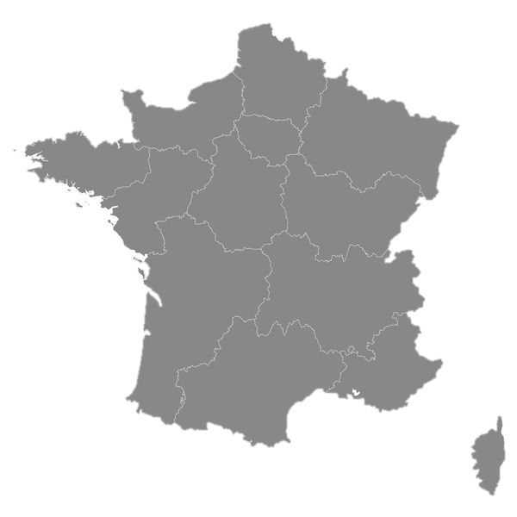
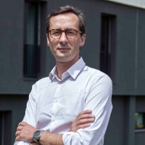
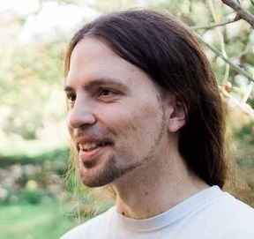
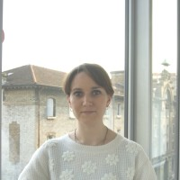

Who am I ?
Paris
&
Frédéric Dehais
Sylvain Chevallier
Marie-Constance Corsi
Toulouse

Slide 4

My PhD
PROTEUS:
mesurer, comprendre et combattre les variabilités dans les interactions cerveau-ordinateur
My PhD:
Understanding and adressing the cross-subjects/sessions variabilities in Burst-CVEP based passive/reactive BCI.

Slide 5
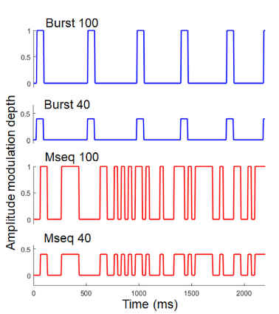
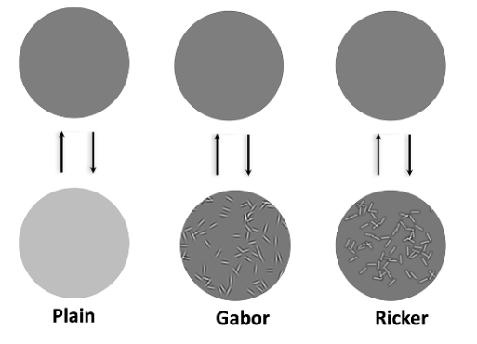
My work
Wokring with Burst-CVEP:
With plain or Ricker patched flickers:

Slide 6
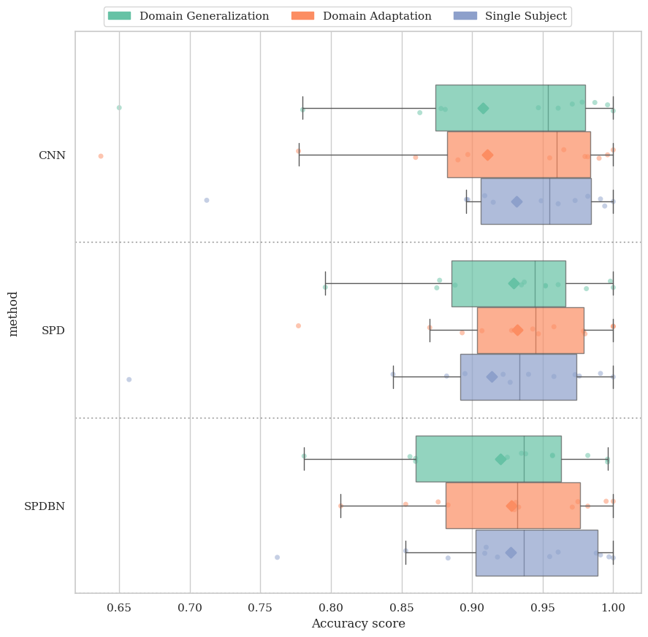

My work : Previous work
In Burst-CVEP based BCI:
Domain adaptation > Domain Generalization
SPDNet on par with the CNN
SPDBNNet is too slow

Slide 7


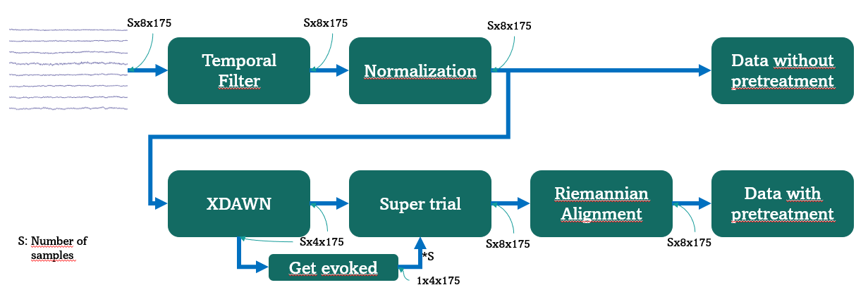

My work : current work
GREEN vs CNN vs TSLDA
With or without pretreatment
Single Subject (SiSu) vs Domain adaptation (DA)
Pretreatment pipeline
Domain Adaptation (DA)
Training/val data:
N subjects et a part of N+1th subject
Testing data:
Rest of data from N+1th subject
Single Subject (SS)
Training/val data:
A part of data from subject i
Testing data:
Rest of data from subject i

Slide 8
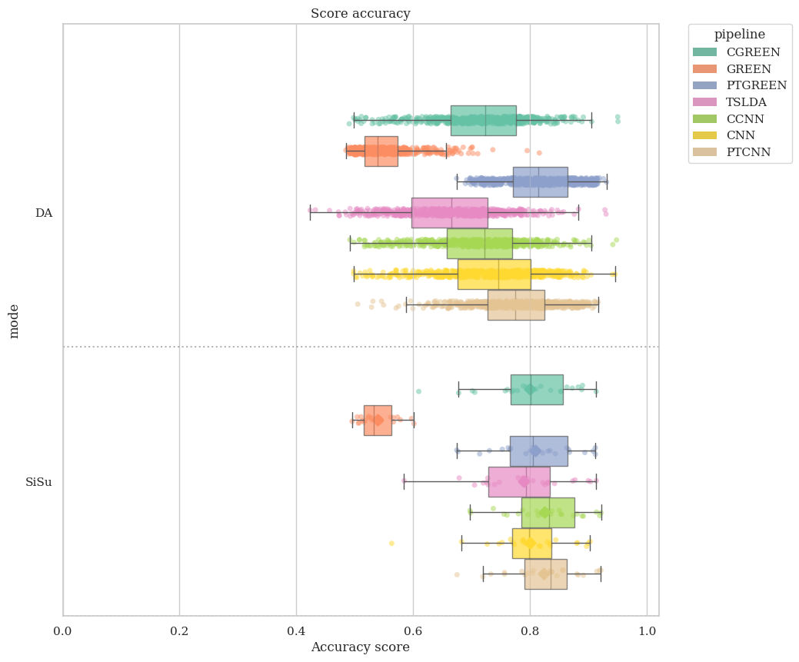
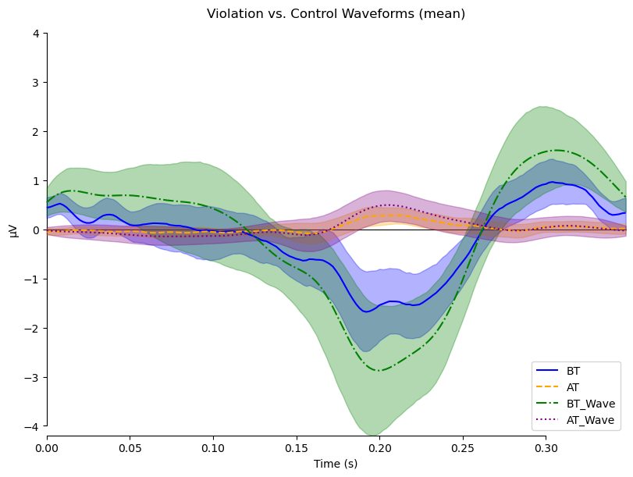
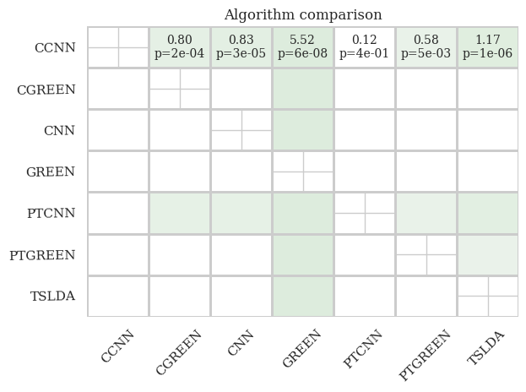
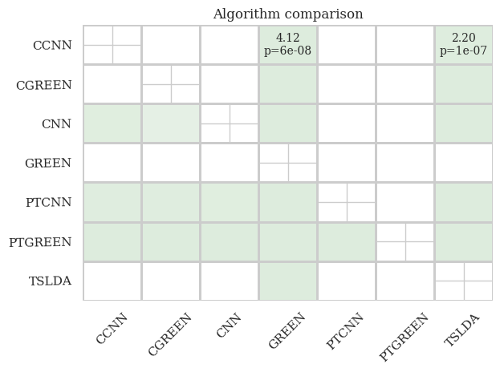
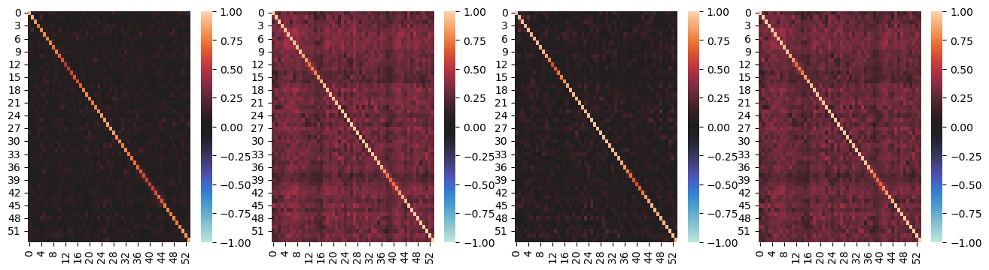
My work : current work
Score balanced accuracy
ERP of the flashes in the different spaces
Statistical difference (SiSU and DA)
Inter-epoch correlation in the different space

Slide 9
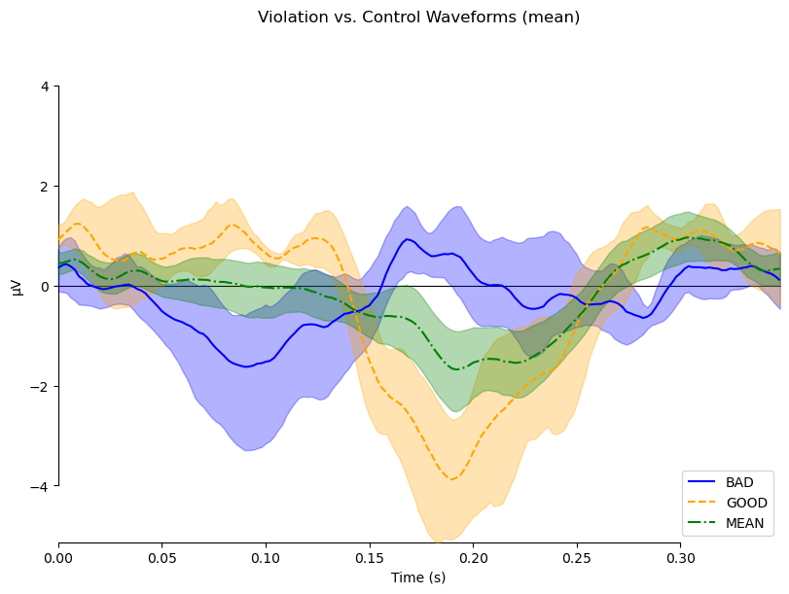
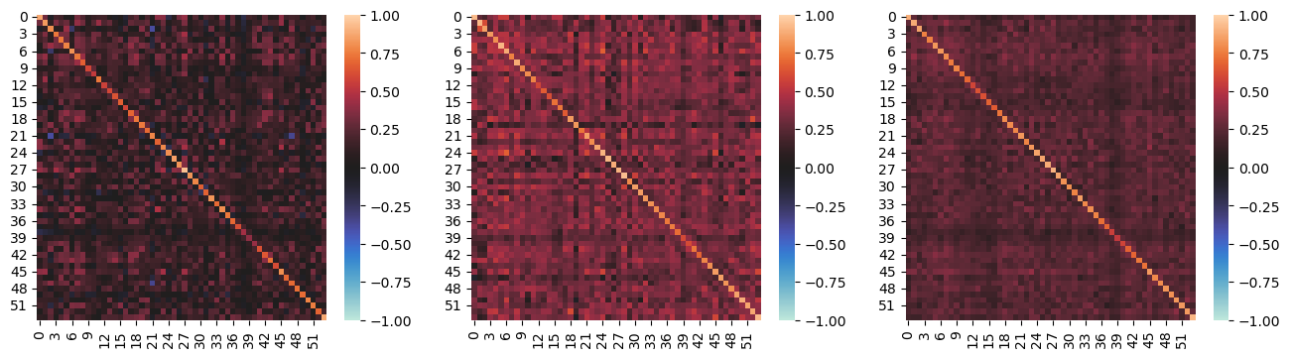
My work : current work
Inter-epoch correlation in the different space
ERP of the flashes in the different spaces

Slide 10
My goals here ?
ENJOY MY STAY WITH YOU !!
Afford helps if needed as side project (ex: Covert attention project)
Make connection and look how you are working in the lab
Main project: Simulation based inference with CVEP and the corresponding EEG data

Slide 11
Thank you for listening !

